Slide 1

MAMAMIND
AI-Powered Maternal Wellness and Family Support System with Wearable Health Monitoring
Department: Computer Science and Design
Guide: Dr. P. Revathy, Professor
Presented by
GOKUL KRISHNA I S (241701016)
SRIYAANCHITA S (241701057)

Slide 2




THE PROBLEM
Maternal Wellness Challenges
Limited Family Coordination
New mothers may experience emotional stress, fatigue and difficulty maintaining self-care routines.
Baby-care responsibilities and household tasks are often difficult to organize and share between parents.
Fragmented Baby-Care Tracking
Lack of Integrated Monitoring
Feeding, sleep, medication and vaccination information may be maintained across separate records.
Maternal wellness activities and wearable readings are rarely brought together in one supportive platform.

Slide 3



OUR SOLUTION
MAMAMIND MOBILE APP
SMART WEARABLE BAND
A family-centered wellness application that:
An ESP32-based monitoring system that:
Provides maternal self-care and AI companionship.
Organizes baby care and shared parenting tasks.
Supports medication reminders and daily wellness routines.
Collects heart rate, SpO₂ and movement information.
Sends available readings to Firebase through Wi-Fi.
Supports passive wellness awareness within the app.
Wi-Fi + Firebase Cloud Firestore

Slide 4
SYSTEM ARCHITECTURE
Mother / Father Users
WEARABLE DATA PATH
ESP32 Wearable
MamaMind Mobile Application
React Native + Expo + TypeScript
Wi-Fi
Cloud Firestore
Core Application Modules
Health Monitoring Screen
Mother
Dashboard
Father
Dashboard
Baby
Dashboard
Shared
Tasks
Self-
Care
AI COMPANION PATH
MamaMind Mobile App
Firebase Authentication + Cloud Firestore
User profiles | Family data | Baby-care records | Activity history
Express AI Backend
AI Companion Responses

Slide 5






MEET THE WEARABLE
THE HARDWARE
THE FUNCTIONS
ESP32
01 HEART RATE
Collects pulse-related readings in BPM.
Conceptual illustration – not a photograph
02 SpO₂
ESP32 – Processing and Wi-Fi communication
Provides blood oxygen saturation estimates.
Heart Rate Sensor – BPM monitoring
SpO₂ Sensor – Oxygen saturation measurement
03 MOVEMENT
Tracks activity context for wellness monitoring.
Movement Sensor – Physical activity information

Slide 6
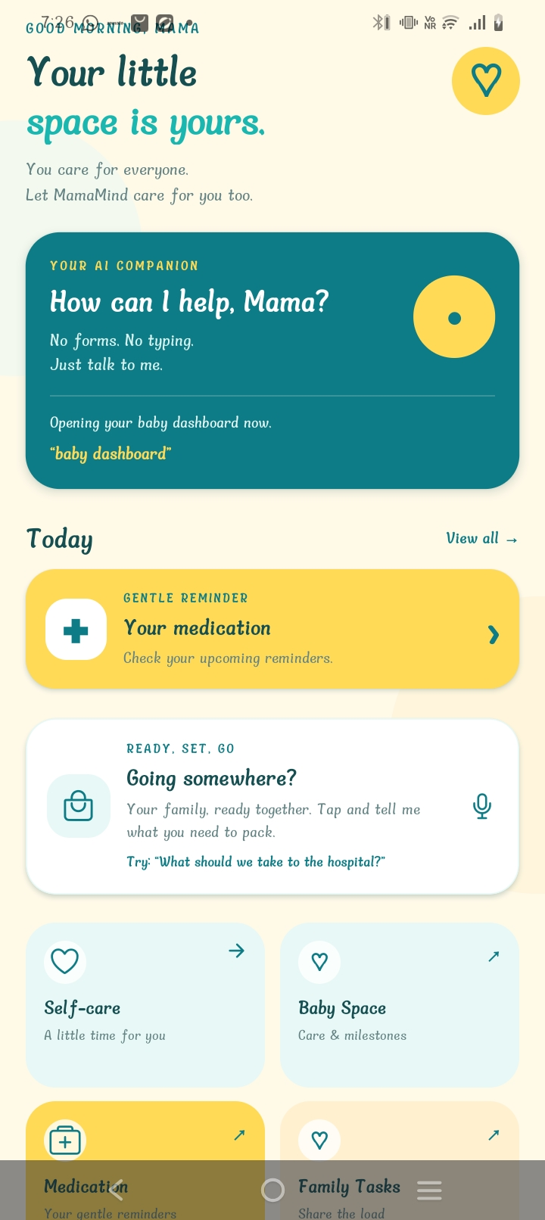






MEET MAMAMIND
THE APPLICATION
A maternal wellness and family support application combining self-care, infant-care tracking, AI assistance and shared parenting.
THE FEATURES
Mother Dashboard
Father Dashboard
Baby Space
AI Companion
Medication Reminders
Meditation & Self-Care
Shared Tasks
Health Monitoring

Slide 7
AI-POWERED WELLNESS SUPPORT
HOW IT WORKS
01
Share Your Feelings
Interact with the AI companion through text or supported voice input.
02
Receive Support
Get general emotional encouragement and wellness guidance.
03
Choose Self-Care
Explore meditation, relaxation activities and daily care suggestions.
04
Stay Connected
Access baby-care information and coordinate support with your partner.

Slide 8

WHO IS MAMAMIND FOR?
NEW MOTHERS
NEW PARENTS
Access gentle self-care reminders and emotional support.
Organize feeding, sleep, diaper and vaccination records.
MamaMind
FATHERS & PARTNERS
MATERNAL WELLNESS SUPPORT
Participate in baby care and shared family responsibilities.
Encourage everyday wellness awareness and healthy routines.
FAMILIES
Improve communication, caregiving coordination and mutual support.

Slide 9
TESTING & FUNCTIONAL EVALUATION
TESTING AREAS
KEY OBSERVATIONS
Authentication and role-based navigation
Passed
Integrated mother, father and baby-care interfaces
Cloud-supported activity and family records
AI-assisted wellness and parenting interactions
Wearable integration requires sensor-level validation
Medication reminders and self-care
Passed
Baby-care record management
Passed
Firebase data synchronization
Passed
AI companion interactions
Passed
Wearable data display
Passed

Slide 10




WHAT'S NEXT?
01 COMPACT WEARABLE
02 SMARTER PERSONALIZATION
Develop a smaller and more comfortable sensor-based wearable design.
Improve context-aware self-care recommendations using validated activity and wellness information.
03 ENHANCED BABY CARE
04 RELIABILITY & SECURITY
Expand vaccination reminders, growth tracking and developmental guidance.
Improve offline support, synchronization, privacy controls and wearable testing.

Slide 11
THANK YOU
MAMAMIND
A little reminder, not another task.
Gokul Krishna I S | Sriyaanchita S

